Slide 1
Java Concurrent API
December 26, 2016

Slide 2
Executor Framework
Working with Executor Framework
Future and callable
Concurrent Collections
BlockingQueue
Array BlockingQueue
Linked BlockingQueue
DelayQueue
SynchronousQueue
BlockingDequeue
Linked BlockingDequeue
Concurrent HashMap
ConcurrentNavigableMap
ConcurrentSkipListMap
CopyOnWriteArrayList
Synchronizers
Semaphore
CountDownLatch
Cyclic Barrier
Exchanger
Phaser
Fail fast vs Fail safe Iterators

Slide 3
Objectives
With the increasingly complexity of concurrent applications, many developers find that Java's low-level threading capabilities are insufficient to their programming needs. In that case, it might be time to discover the Java Concurrency Utilities.
The course introduces software developers familiar with basic Java threading to the Java Concurrency Utilities packages and framework.

Slide 4
Need of Concurrency API ?
The Java platform provides low-level threading capabilities that enable developers to write concurrent applications where different threads execute simultaneously. Standard Java threading has some downsides, however:
Java's low-level concurrency primitives (synchronized, volatile, wait(), notify(), and notifyAll()) aren't easy to use correctly. Threading hazards like deadlock, thread starvation, and race conditions, which result from incorrect use of primitives, are also hard to detect and debug.
Relying on synchronized to coordinate access between threads leads to performance issues that affect application scalability, a requirement for many modern applications.
Java's basic threading capabilities are too low level. Developers often need higher level constructs like semaphores and thread pools, which Java's low-level threading capabilities don't offer. As a result, developers will build their own constructs, which is both time consuming and error prone.

Slide 5
Concurrency API
The Java Concurrency Utilities framework is a library of types(Classes or interfaces) that are designed to be used as building blocks for creating concurrent classes or applications. These types are thread-safe, have been thoroughly tested, and offer high performance.
Types in the Java Concurrency Utilities are organized into small frameworks; namely, Executor framework, synchronizer, concurrent collections, locks, atomic variables, and Fork/Join. They are further organized into a main package and a pair of subpackages:
java.util.concurrent contains high-level utility types that are commonly used in concurrent programming. Examples include semaphores, barriers, thread pools, and concurrent hashmaps.
The java.util.concurrent.atomic subpackage contains low-level utility classes that support lock-free thread-safe programming on single variables.
The java.util.concurrent.locks subpackage contains low-level utility types for locking and waiting for conditions, which are different from using Java's low-level synchronization and monitors.

Slide 6
Executor framework

Slide 7
The Executor framework
Thread Pool
Thread pool is a pool of already created worker thread ready to do the job. The thread pool is one of essential facility any multi-threaded server side Java application requires. One example of using thread pool is creating a web server, which processes client request. If only one thread is used to process client request, than it subsequently limit how many client can access server concurrently. In order to support large number of clients, you may decide to use one thread per request paradigm, in which each request is processed by separate Thread, but this require Thread to be created, when request arrived. Since creation of Thread is time consuming process, it delays request processing. Since Thread are usually created and pooled when application starts, your server can immediately start request processing, which can further improve server’s response time. In short, we need thread pools to better mange threads and decoupling task submission from execution. Thread pool with Executor framework introduced in Java 5 is an excellent thread pool provided by library.

Slide 8
Deciding size of a thread pool
Most of the time people don’t think about pool size for their thread pool and they create any number of threads in pool with their choice without thinking much on it. But, if you don’t know how to decide number of threads in pool that could be more dangerous and could spoil your performance and memory management badly.
There are few factors mentioned below on which thread pool size depends:
Available Processors
Ideal pool size is available processors (AP) in your system or AP+1. Here is an example, how to get number of processors available in your system using Java.
int poolSize = Runtime.getRuntime().availableProcessors(); OR int poolSize = Runtime.getRuntime().availableProcessors() + 1;
This is ideal pool size, if your multithreaded task is kind of computation, where threads are not getting block, wait on I/O or some combination.
Behavior of Tasks
If you have different category of tasks with different behaviours that consider you thread pool size according to that behaviour.
Amdahl’s Law
According to Amdahl’s Law, if P is the proportion of task can be executed parallel then maximum speed up can get with N number of processors (threads) is:
Speed up = 1/ (1-P) + P/N
Read More: http://wiserhawk.blogspot.in/2016/05/how-to-decide-pool-size-for-thread-pools.html

Slide 9
The Executor framework
Executor
An executor is someone who is responsible for executing, or following through, on an assigned task or duty.
The Java Executor Framework has been introduced in Java 1.5 and it is a part of java concurrency package. The Executor framework is an abstraction layer over the actual implementation of java multithreading. It is the first concurrent utility framework in java and used for standardizing invocation, scheduling, execution and control of asynchronous tasks in parallel threads. The execution rules are defined during the creation of the constructor. And then the executor runs the concurrent threads following the rules set earlier.
Executor implementation in java uses thread pools which consists of worker threads. The entire management of worker threads is handled by the framework. So the overhead in memory management is much reduced compared to earlier multithreading approaches.

Slide 10
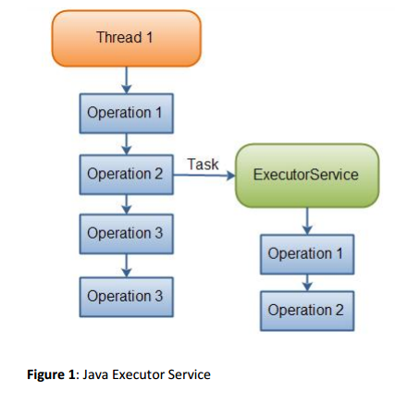
Before java 1.5, multithreading applications were created using thread group, thread pool or custom thread pool. As a result the entire thread management was the responsibility of the programmer keeping in mind the following points.
Thread synchronization
Thread waiting
Thread joining
Thread locking
Thread notification
Handling dead lock

Slide 11

Inside the Executor framework
The Executor framework is based on the Executor interface, which describes an executor as any object capable of executing java.lang.Runnable tasks. This interface declares the following solitary method for executing a Runnable task:
You submit a Runnable task by passing it to execute(Runnable). If the executor cannot execute the task for any reason (for instance, if the executor has been shut down), this method will throw a RejectedExecutionException.
The key concept is that task submission is decoupled from the task-execution policy, which is described by an Executor implementation. The runnable task is thus able to execute via a new thread, a pooled thread, the calling thread, and so on.
Five of ExecutorService's methods are especially noteworthy:
boolean awaitTermination(long timeout, TimeUnit unit) - blocks the calling thread until all tasks have completed execution after a shutdown request, the timeout occurs, or the current thread is interrupted, whichever happens first.

Slide 12
boolean isShutdown() - returns true when the executor has been shut down.
void shutdown() - initiates an orderly shutdown in which previously submitted tasks are executed but no new tasks are accepted.
<T> Future<T> submit(Callable<T> task) - submits a value-returning task for execution and returns a Future representing the pending results of the task.
Future<?> submit(Runnable task) - submits a Runnable task for execution and returns a Future representing that task.
Executor factory methods
Executors offers several factory methods for obtaining different kinds of executors that offer specific thread-execution policies.
The newFixedThreadPool () returns a ThreadPoolExecutor instance with an initialized and unbounded queue and a fixed number of threads.
The newCachedThreadPool () returns a ThreadPoolExecutor instance initialized with an unbounded queue and unbounded number of threads.
The newSingleThreadExecutor() returns an ThreadPoolExecutor that uses a single worker thread operating off an unbounded queue

Slide 13
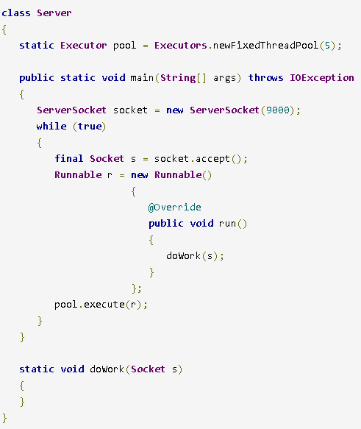
Working with the Executor framework
The above code, uses newFixedThreadPool(int) to obtain a thread pool-based executor that reuses five threads. It also replaces new Thread(r).start(); with pool.execute(r);for executing runnable tasks via any of these threads.

Slide 14
Future and Callable
One of the advantages of the Executor framework is that you can run concurrent tasks that may return a result after processing the task. The Java Concurrency API achieves this with the following two interfaces Callable and Future.
Callable : This interface has the call() method. In this method, you have to implement the logic of a task. TheCallable interface is a parameterized interface, meaning you have to indicate the type of data the call() method will return.
Future : This interface has some methods to obtain the result generated by a Callable object and to manage its state.
Callable Future Example
In this example, we are creating a FactorialCalculator which is of type Callable. It means you will override it’scall() method and after calculation, you will return the result from call() method. This result later can be retrieved from Future reference held by main program.

Slide 15
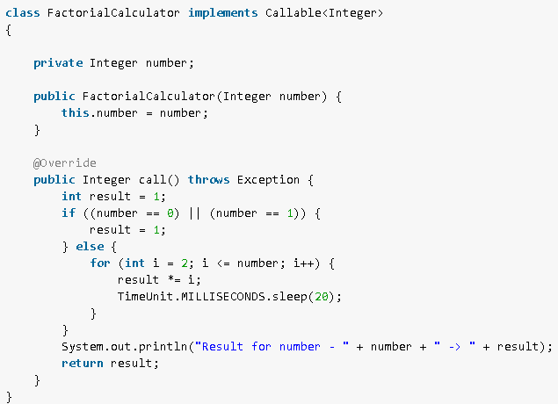
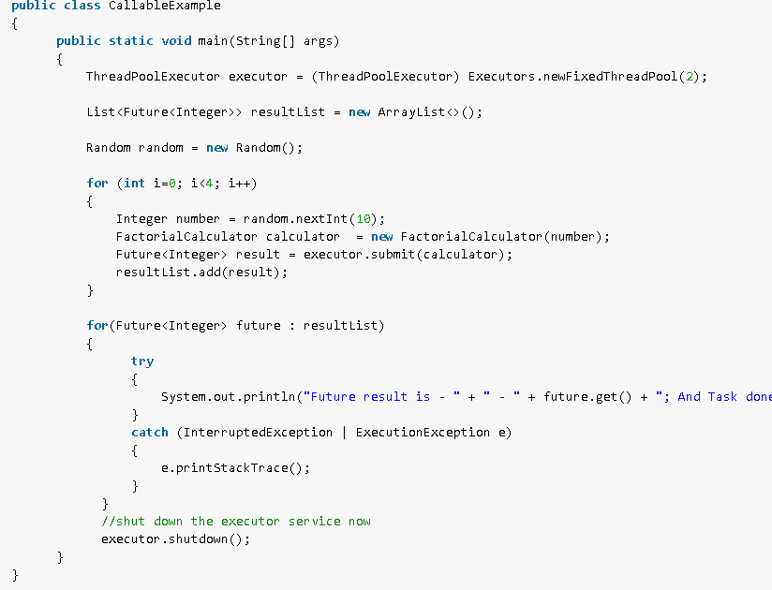
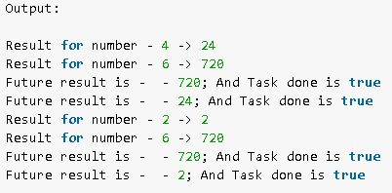
Now let’s test the above factorial calculator using two threads and 4 numbers.

Slide 16
Here you sent a Callable object to be executed in an executor using the submit() method. This method receives aCallable object as a parameter and returns a Future object that you can use with two main objectives:
a) You can control the status of the task: you can cancel the task and check if it has finished. For this purpose, you have used the isDone() method to check if the tasks had finished.
b) You can get the result returned by the call() method. For this purpose, you have used the get() method. This method waits until the Callable object has finished the execution of the call() method and has returned its result. If the thread is interrupted while the get() method is waiting for the result, it throws an InterruptedExceptionexception. If the call() method throws an exception, this method throws an ExecutionException exception.
c) The Future interface provides another version of the get() method i.e. get(longtimeout,TimeUnitunit). This version of the get method, if the result of the task isn’t available, waits for it for the specified time. If the specified period of time passes and the result isn’t yet available, the method returns a null value.

Slide 17
Exercise
implement an example that will simulate a web server processing requests from various clients.
Create a factorial calculator which returns the factorial of the integer. Call it to calculate factorial of 10 random numbers concurrently and store the result in a list.
Implement an example where a user can be validated by two mechanisms. The user will be validated if one of those mechanisms validates it. Make sure to return the result as soon as it gets validated by any one of the mechanisms.
Implement an example to schedule execution of a task after a given period of time.

Slide 18
Concurrent Collections

Slide 19
Concurrent Collections
Multiple concurrently running threads modifying a data structure may possibly damage it. Choices to avoid this are:
Supplying a lock for the data structure
Choose a thread safe implementation of the data structure
Concurrency framework provides implementation of several commonly used collections classes optimized for concurrent operations
Availabe ThreadSafe Colllections
BlockingQueue
BlockingDeque
ConcurrentMaps

Slide 20
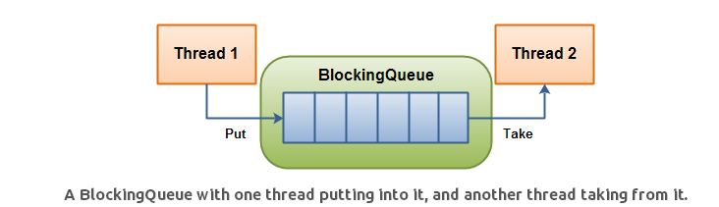
BlockingQueue
A Queue that additionally supports operations that
wait for the queue to become non-empty when retrieving an element
wait for space to become available in the queue when storing an element.
BlockingQueue implementations are thread-safe.
All queuing methods are atomic in nature
Uses internal locks or other forms of concurrency control .
Notes:
http://docs.oracle.com/javase/8/docs/api/java/util/concurrent/BlockingQueue.html

Slide 21
BlockingQueue
A BlockingQueue does not accept null elements.
Implementations throw NullPointerException on attempts to add, put or offer a null.
A null is used as a sentinel value to indicate failure of poll operations.
Usage
Two of the most common uses of BlockingQueue is to implement Producer Consumer design pattern and implementing Bounded buffer in Java.
BlockingQueue amazingly simplifies implementation of Producer-Consumer design pattern by providing outofbox support of blocking on put() and take(). Developer doesn't need to write confusing and critical piece of wait-notify code to implement communication
Operation | Throws exception | Special value | Blocks | Times out
Insert | add(e) | offer(e) | put(e) | offer(e, time, unit)
Remove | remove() | poll() | take() | poll(time, unit)
Examine | element() | peek() | not applicable | not applicable

Slide 22
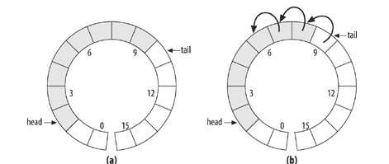
ArrayBlockingQueue
A bounded, blocking queue that Implements the BlockingQueue interface
stores the elements internally in an array in FIFO order
The head of the queue is the element which has been in queue the longest time
tail of the queue is the element which has been in the queue the shortest time.
supports an optional fairness policy for ordering waiting producer and consumer threads.
queue constructed with fairness set to true grants threads access in FIFO order.
Fairness generally decreases throughput but reduces variability and avoids starvation.
Notes:
http://docs.oracle.com/javase/8/docs/api/java/util/concurrent/ArrayBlockingQueue.html

Slide 23
ArrayBlockingQueue
Constructors:
ArrayBlockingQueue(int capacity)
ArrayBlockingQueue(int capacity, boolean fair)
ArrayBlockingQueue(int capacity, boolean fair, Collection<? Extends E> c)
Use in a producer/consumer scenario if you want to throttle some sort of request of producers
http://docs.oracle.com/javase/6/docs/api/java/util/concurrent/ArrayBlockingQueue.html

Slide 24
LinkedBlockingQueue
An optionally-bounded blocking queue based on linked nodes.
The head of the queue is that element that has been on the queue the longest time.
The tail of the queue is that element that has been on the queue the shortest time.
New elements are inserted at the tail of the queue.
queue retrieval operations obtain elements at the head of the queue.
Linked queues typically have higher throughput than array-based queues but less predictable performance in most concurrent applications.
Constructor Summary
LinkedBlockingDeque()
Creates a LinkedBlockingDeque with a capacity of Integer.MAX_VALUE.
LinkedBlockingDeque(Collection<? extends E> c)
Creates a LinkedBlockingDeque with a capacity of Integer.MAX_VALUE, initially containing the elements of the given collection, added in traversal order of the collection's iterator.
LinkedBlockingDeque(int capacity)
Creates a LinkedBlockingDeque with the given (fixed) capacity.
Notes:
http://docs.oracle.com/javase/7/docs/api/java/util/concurrent/LinkedBlockingQueue.html
The optional capacity bound constructor argument serves as a way to prevent excessive queue expansion (because if capacity is unspecified, then it is equal to Integer.MAX_VALUE)

Slide 25
ArrayBlockingQueue vs LinkedBlockingQueue
.
ArrayBlockingQueue | LinkedBlockingQueue
ArrayBlockingQueue is a queue of a fixed size. | LinkedBlockingQueue is an optionally bounded queue built on top of Linked nodes.
ArrayBlockingQueue uses single-lock double condition algorithm | LinkedBlockingQueue is variant of the "two lock queue" algorithm and it has 2 locks 2 conditions ( takeLock , putLock)
If you can estimate with reasonable accuracy the size of your queue then use ArrayBlockingQueue | use LinkedBlockingQueue when accuracy of size is unpredictable

Slide 26
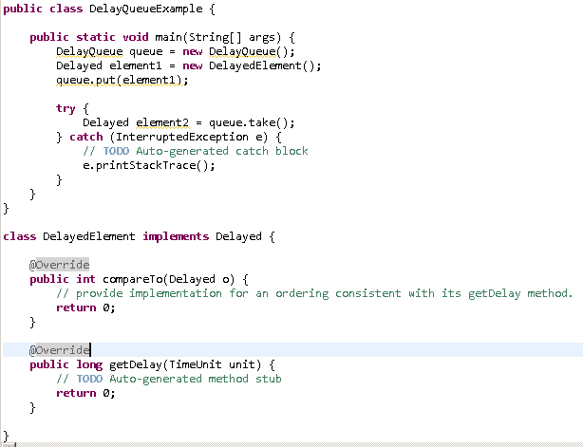
DelayQueue
DelayQueue is an unbounded queue..
Allows objects that implements Delayed interface.
Element can only be taken when its delay has expired.
At the head of the queue , element with furthest expired delay time is found.
An element is expired when getDelay() <=0.
Notes:
The Delayed interface also extends Comparable interface, used internally to order the elements in the queue, so they are released ordered by their expiration time
The TimeUnit instance passed to the getDelay() method is an Enum that tells which time unit the delay should be returned in. The TimeUnit enum can take these values:DAYS ,HOURS, MINUTES ,SECONDS ,MILLISECONDS,MICROSECONDS ,NANOSECONDS

Slide 27
DelayQueue
Usage
Control flow - we know that an order takes 60 seconds to process, so don't read the next order off of the queue until the object has been there for at least 60 seconds.
Message flow - A highly asynchronous system where we send off requests to 2 or 3 external services and then release the next task to process the order N seconds later once we know the first batch of jobs will at least have had a chance of completing.
Message batching - maybe orders of a certain type are bursty, so lets not process orders received in the last N seconds so we can see if similar orders come in shortly after that can be processed as a batch on the next run.
Message priorities - different messages or different customers could get a slightly higher quality of service with a lower or zero delay.

Slide 28
SynchronousQueue
A blocking queue in which each insert operation must wait for a corresponding remove operation by another thread, and vice versa.
Follows hand-off pattern.
A synchronous queue does not have any internal capacity.
peek operation is not allowed.
you cant iterate as there is nothing to iterate.
supports an optional fairness policy for ordering waiting producer and consumer threads.
By default ordering is not guaranteed.
However, a queue constructed with fairness set to true grants threads access in FIFO order.
call to a SynchronousQueue will not return until there is a corresponding take()
Notes:
There are times when you need to process different actions in different threads, but they need to be coordinated using a hand-off pattern. In other words, you can have a child thread that does some work, and then sits and waits for more work from a queue. On the other side, you can have a producer thread that chugs along until it needs to hand-off a portion of its work activity to another thread. With a SynchronousQueue, both sides of the queue (consumer and producer) will block until there is a corresponding producer and consumer, respectively.
The requirement is that upon insertion into the queue, the producer will block until there is a consumer ready to pull a message off the queue, and vice versa .. hence the
http://docs.oracle.com/javase/7/docs/api/java/util/concurrent/SynchronousQueue.html

Slide 29
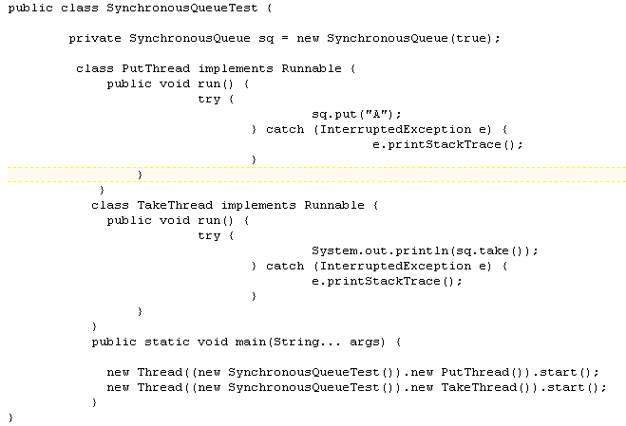
SynchronousQueue
Usage
default BlockingQueue used for the Executors.newCachedThreadPool() methods.
Can be used when we want Single threading a task without queuing further requests.
Improve application performance. If you must have a hand-off between threads, you will need some synchronization object. If you can satisfy the conditions required for its use, SynchronousQueue is the fastest synchronization

Slide 30
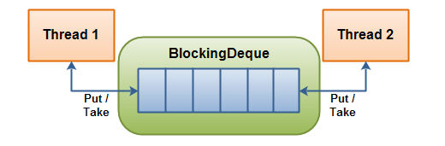
BlockingDequeue
An interface extends the BlockingQueue interface.
A Deque that
additionally supports blocking operations that wait for the deque to become non-empty when retrieving an element,
and wait for space to become available in the deque when storing an element.
Doesn’t permit null values
First Element (Head)
 | Throws exception | Special value | Blocks | Times out
Insert | addFirst(e) | offerFirst(e) | putFirst(e) | offerFirst(e, time, unit)
Remove | removeFirst() | pollFirst() | takeFirst() | pollFirst(time, unit)
Examine | getFirst() | peekFirst() | not applicable | not applicable
Last Element (Tail)
 | Throws exception | Special value | Blocks | Times out
Insert | addLast(e) | offerLast(e) | putLast(e) | offerLast(e, time, unit)
Remove | removeLast() | pollLast() | takeLast() | pollLast(time, unit)
Examine | getLast() | peekLast() | not applicable | not applicable

Slide 31
BlockingDequeue interface
A BlockingDeque implementation may be used directly as a FIFO BlockingQueue.
The methods inherited from the BlockingQueue interface are precisely equivalent to BlockingDeque methods as indicated in the following table:
http://docs.oracle.com/javase/7/docs/api/java/util/concurrent/BlockingDeque.html
BlockingQueue Method | Equivalent BlockingDeque Method
Insert
add(e) | addLast(e)
offer(e) | offerLast(e)
put(e) | putLast(e)
offer(e, time, unit) | offerLast(e, time, unit)
Remove
remove() | removeFirst()
poll() | pollFirst()
take() | takeFirst()
poll(time, unit) | pollFirst(time, unit)
Examine
element() | getFirst()
peek() | peekFirst()

Slide 32
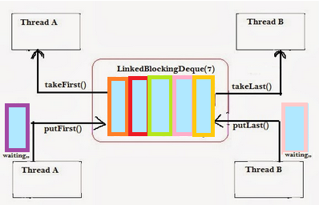
LinkedBlockingDeque
An optionally-bounded blocking deque based on linked nodes.
Attempts to put an element into a full LinkedBlockingDeque will result in the operation blocking and attempts to take an element from an empty LinkedBlockingDeque will similarly block.
You can insert and remove the element from both the ends.
Elements are linked to each other and know who is in front and at the back.
Concurrent scalable optionally bounded FIFO blocking deque backed by linked nodes.

Slide 33
LinkedBlockingDeque
Constructor Details
LinkedBlockingDeque() : Creates a LinkedBlockingDeque with a capacity of Integer.MAX_VALUE.
LinkedBlockingDeque(int capacity) : Creates a LinkedBlockingDeque with the given (fixed) capacity.
LinkedBlockingDeque(Collection<? extends E> c) : Creates a LinkedBlockingDeque with a capacity of Integer.MAX_VALUE, initially containing the elements of the given collection, added in traversal order of the collection's iterator.
Usage
Useful if threads are both producing and consuming elements of the same queue
Also useful if the producer thread needs to insert at both ends of the queue, and the consuming thread needs to remove from both ends of the queue

Slide 34
Exercise
Implement an example with the following two tasks:
One that adds data to a list massively. If the list is full the method should blocks the execution until there is an empty space in the list.
One that removes data from the same list massively. If the list is empty, the method blocks the execution of its thread until there are elements in the list.
Consider there is a social web sites which leaves the users comments editable for specific time, after expiration those comments become non editable. (Hint : Store the elements in a collection, remove it and put it in another collection after expiration.)
Implement an example where First thread, publishing cricket score, and second thread is consuming it. Keep in mind cricket scores needs to be live i.e. latest, so we cannot accumulate multiple scores.

Slide 35
ConcurrentMap
A Map providing additional atomic methods.
Doesn’t allow null values.
Provides additional Atomic operations:
public V putIfAbsent(K key, V value)
boolean remove(Object key, Object value)
public V replace(K key, V value)
public V replace(K key, V oldValue,V newValue)
Memory consistency effects: As with other concurrent collections, actions in a thread prior to placing an object into a ConcurrentMap as a key or value happen-before actions subsequent to the access or removal of that object from the ConcurrentMap in another thread.
Notes:
http://docs.oracle.com/javase/7/docs/api/java/util/concurrent/ConcurrentMap.html
The main reason that nulls aren't allowed in ConcurrentMaps (ConcurrentHashMaps, ConcurrentSkipListMaps) is that ambiguities that may be just barely tolerable in non-concurrent maps can't be accommodated. The main one is that if map.get(key) returns null, you can't detect whether the key explicitly maps to null vs the key isn't mapped. In a non-concurrent map, you can check this via map.contains(key), but in a concurrent one, the map might have changed between calls.
http://javapapers.com/core-java/fail-fast-vs-fail-safe/

Slide 36

ConcurrentHashMap
A hash table supporting full concurrency of retrievals and adjustable expected concurrency for updates.
All operations are thread-safe.
Retrieval operations do not entail locking.
No support for locking the entire table.
Only lock a portion of Map instead of whole Map during update.
Iterator returned by ConcurrentHashMap is weekly consistent, fail safe and never throw ConcurrentModificationException.
During putAll() and clear() operations, concurrent read may only reflect insertion or deletion of some entries.
PutIfAbsent() –
If the specified key is not already associated with a value, associate it with the given value. This is equivalent to
except that the action is performed atomically.
Notes:
http://www.burnison.ca/articles/the-concurrency-of-concurrenthashmap
Fail Safe : This iterators doesn’t throw exception if the Collection is modified concurrently. Because these iterators works the clone of the Collection not with the original.

Slide 37
ConcurrentHashMap
Fully parametrized constructor of ConcurrentHashMap takes 3 parameters, initialCapacity, loadFactor and concurrencyLevel.
1) initialCapacity 2) loadFactor 3) concurrencyLevel
Constructors
ConcurrentHashMap<K,V> ()
ConcurrentHashMap<K,V> >(int initialcapacity)
ConcurrentHashMap<K,V> () (int initialcapacity,float loadfactor,int concurrencyLevel)

Slide 38
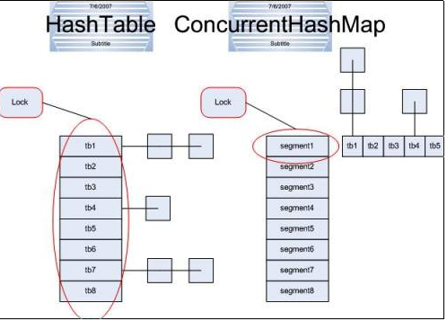
ConcurrentHashMap
The Map into small portion which is defined by concurrency level. Default concurrency level is 16, and accordingly Map is divided into 16 part and each part is governed with different lock.
BEST PRACTICE USAGE
creating their ConcurrentHashMap instances with parameters something like this:
ConcurrentHashMap<String, MyClass> m =new ConcurrentHashMap<String, MyClass>(8, 0.9f, 1);
default ConcurrentHashMap parameters should be the exception, not the rule!
useful if there are lots of parallel readers and writers.
Notes:
http://www.javacodegeeks.com/2013/05/experiment-with-concurrenthashmap.html
ConcurrentHashMap is best suited when you have multiple readers and few writers. If writers outnumber reader, or writer is equal to reader, than performance of ConcurrentHashMap effectively reduces to synchronized map or Hashtable. Performance of CHM drops, because you got to lock all portion of Map, and effectively each reader will wait for another writer, operating on that portion of Map. ConcurrentHashMap is a good choice for caches, which can be initialized during application start up and later accessed my many request processing threads. As javadoc states, CHM is also a good replacement of Hashtable and should be used whenever possible, keeping in mind, that CHM provides slightly weeker form of synchronization than Hashtable. Read more: http://javarevisited.blogspot.com/2013/02/concurrenthashmap-in-java-example-tutorial-working.html#ixzz2xwCx7Qbc

Slide 39
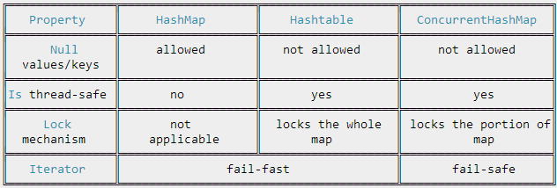
ConcurrentHashMap
HashMap vs. HashTable vs. ConcurrentHashMap
ConcurrentHashMap is very similar to HashTable but it provides better concurrency level. You might know , you can synchonize HashTable using Collections.synchronizedMap(Map). So what is difference between ConcurrentHashMap and Collections.synchronizedMap(Map) In case of Collections.synchronizedMap(Map), it locks whole HashTable object but in ConcurrentHashMap, it locks only part of it. You will understand it in later part. Another difference is that ConcurrentHashMap will not throw ConcurrentModification exception if we try to modify ConcurrentHashMap while iterating it.

Slide 40
ConcurrentHashMap
Key Points to Remember on ConcurrentHashMap
ConcurrentHashMap only locks a portion of the collection on update.
ConcurrentHashMap is better than Hashtable and synchronized Map.
ConcurrentHashMap is failsafe does not throws ConcurrentModificationException.
null is not allowed as a key or value in ConcurrentHashMap.
Level of concurrency can be chosen by the programmer on a ConcurrentHashMap while initializing it.
Please follow the below link for example-
http://www.java2blog.com/2014/12/concurrenthashmap-in-java.html

Slide 41
ConcurrentNavigableMap
A ConcurrentMap supporting NavigableMap operations, and recursively so for its navigable sub-maps.
The "submaps" are the maps returned by various methods like
headMap(): The headMap(T toKey) method returns a view of the map containing the keys which are strictly less than the given key.
subMap() :The tailMap(T fromKey) method returns a view of the map containing the keys which are greater than or equal to the given fromKey.
tailMap(): The tailMap(T fromKey) method returns a view of the map containing the keys which are greater than or equal to the given fromKey.
The ConcurrentNavigableMap interface contains a few more methods that might be of use. For instance:
descendingKeySet()
descendingMap()
navigableKeySet()

Slide 42
ConcurrentSkipListMap
Elements are fetched in natural order, to get user defined order we can use Comparator.
Null value and null keys are not allowed.
ConcurrentSkipListMap extends NavigableMap, so it has the methods like ceilingEntry, ceilingKey, firstEntry, floorEntry etc which will return Map. Entry or NavigableMap.
Constructor of ConcurrentSkipListMap
ConcurrentSkipListMap() : It creates a new empty map into which mappings are sorted according to the keys natural order.
ConcurrentSkipListMap(Comparator<? super K> comparator) : It creates a new vacate map into which the mappings are sorted according to the defined comparator.
ConcurrentSkipListMap(Map<? extends K,? extends V> m) : It creates a new map that contains the same mappings of a given map into which mappings are sorted according to the keys natural order.
ConcurrentSkipListMap(SortedMap<K,? extends V> m) : It creates a new map that contains the same mappings and follows the order like the defined sorted map.
Usage - If you need faster in-order traversal, and can afford the extra cost for insertion.
Please follow the below link for example- http://javapapers.com/java/java-concurrentskiplistmap/
Notes:
http://codepatch.wordpress.com/2012/09/23/comparing-concurrenthashmap-vs-concurrentskiplistmap-part-2/

Slide 43
CopyOnWriteArrayList
CopyOnWriteArrayList implements List interface like ArrayList, Vector and,LinkedList but its a thread-safe collection and it achieves its thread-safety in a slightly different way than Vector or other thread-safe collection class.
As name suggest CopyOnWriteArrayList creates copy of underlying ArrayList with every mutation operation e.g. add or set. Normally CopyOnWriteArrayList is very expensive because it involves costly Array copy with every write operation but its very efficient if you have a List where Iteration outnumber mutation e.g. you mostly need to iterate the ArrayList and don't modify it too often.
Iterator of CopyOnWriteArrayList is fail-safe and doesn't throw ConcurrentModificationException even if underlying CopyOnWriteArrayList is modified once Iteration begins because Iterator is operating on separate copy of ArrayList. Consequently all the updates made onCopyOnWriteArrayList is not available to Iterator.
Difference between ArrayList and CopyOnWriteArrayList-
1) First and foremost difference between CopyOnWriteArrayList and ArrayList in Java is that CopyOnWriteArrayList is a thread-safe collection while ArrayList is not thread-safe and can not be used in multi-threaded environment.

Slide 44
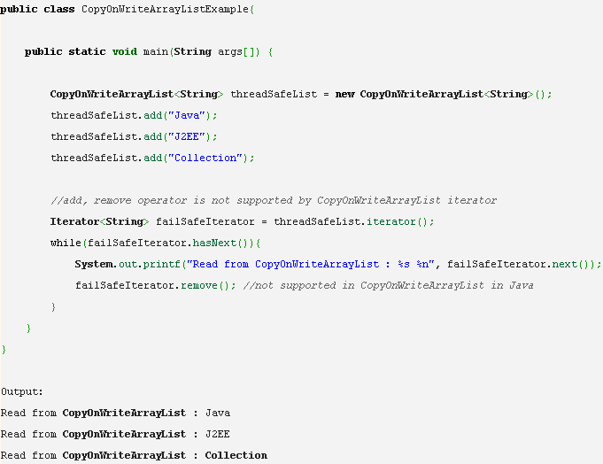
2) Second difference between ArrayList and CopyOnWriteArrayList is that Iterator of ArrayList is fail-fast and throw ConcurrentModificationException once detect any modification in List once iteration begins but Iterator of CopyOnWriteArrayList is fail-safe and doesn't throw ConcurrentModificationException.
3) Third difference between CopyOnWriteArrayList vs ArrayList is that Iterator of former doesn't support remove operation while Iterator of later supports remove() operation.

Slide 45
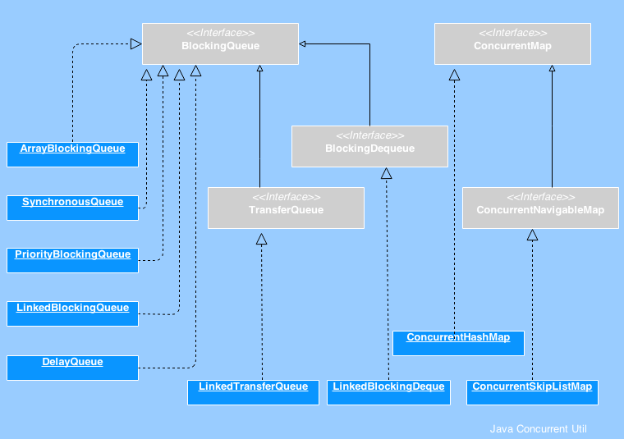
Concurrent Collection - Summary

Slide 46
Exercise
Implement Producer - Consumer problem using ArrayBlockingQueue.
Implement Producer - Consumer problem using LinkedBlockingQueueLinkedBlockingDeque.
Implement Producer - Consumer problem using LinkedBlockingDeque.
Implement Producer - Consumer problem using SynchronousQueue.
Try to use putIfAbsent() method for ConcurrentHashMap
Please use the link for solution-.
http://javapapers.com/java/java-concurrent-collections/

Slide 47
Synchronizers

Slide 48
Synchronizers: Introduction
Enable threads to wait for one another, allowing them to coordinate their activities.
Components of Synchronizing
Acquire and
Release shared resources on condition
Features:
Wait- Blocking/Non-Blocking/Interruptible/Timed wait
Shared/Exclusive Acquire and Release
Notification- fair/unfair

Slide 49
Semaphore
A semaphore is a thread-synchronization construct for controlling thread access to a common resource. It's often implemented as a protected variable whose value is incremented by an acquire operation and decremented by a release operation.
The acquire operation either returns control to the invoking thread immediately or causes that thread to block when the semaphore's current value reaches a certain limit. The release operation decreases the current value, which causes a blocked thread to resume.
Semaphores whose current values can be incremented past 1 are known as counting semaphores, whereas semaphores whose current values can be only 0 or 1 are known as binary semaphores or mutexes. In either case, the current value cannot be negative.
Has certain no. of permits which can be acquired or released
Restricts number of threads that can have concurrent access
to a resource
acquire(), tryAcquire(), acquireInterrruptibly()
E.g. A train reservation center having multiple
service counters servicing a single traveller queue

Slide 50
Semaphore
Advantages
Release doesn’t have to be called by the same thread as acquire
increase the number of permits at runtime
acquireInterruptibly()
tryAcquire()
Always ensure to Release lock that you acquire
Usage
Semaphores might be appropriate for signaling between processes. E.g. A train reservation center having multiple service counters servicing a single traveller queue
The correct use of a semaphore is for signaling from one task to another.
Use a semaphore when you (thread) want to sleep till some other thread tells you to wake up. Semaphore 'down' happens in one thread (producer) and semaphore 'up' (for same semaphore) happens in another thread (consumer).
Limiting concurrent access to disk (this can kill performance due to competing disk seeks)
Thread creation limiting
JDBC connection pooling / limiting

Slide 51
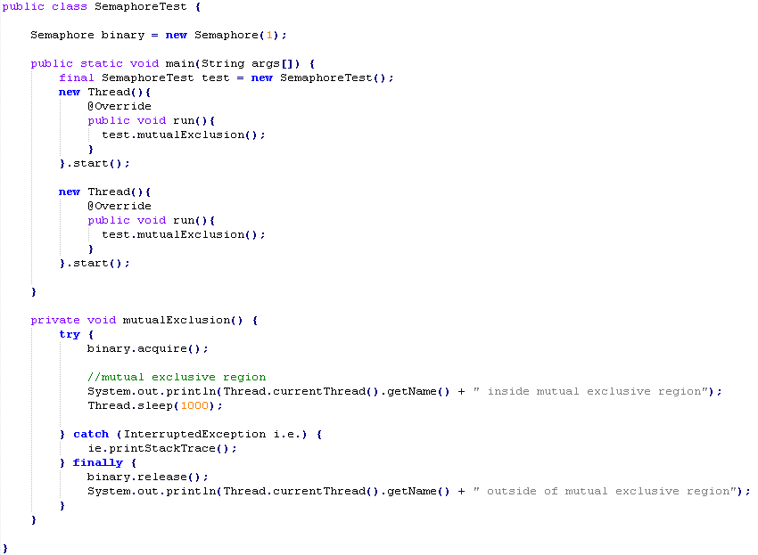
Some Scenario where Semaphore can be used:
1) To implement better Database connection pool which will block if no more connection is available instead of failing and handover Connection as soon as its available.
2) To put a bound on collection classes. by using semaphore you can implement bounded collection whose bound is specified by counting semaphore.

Slide 52
CountDownLatch
A countdown latch is a thread-synchronization construct that causes one or more threads to wait until a set of operations being performed by other threads finishes. It consists of a count and "cause a thread to wait until the count reaches zero" and "decrement the count" operations.
initialized with a count of one serves as a simple on/off latch, or gate
This count is essentially the number of threads, for which latch should wait.
Count value can be set only once.
Thread wait on Latch by calling countDownLatch.await()
count is decremented by calls to the countDown()
Once the count become zero it is no longer usable.

Slide 53
CountDownLatch
Countdown latches are useful for decomposing a problem into smaller pieces and giving a piece to a separate thread, as follows:
A main thread creates a countdown latch with a count of 1 that's used as a "starting gate" to start a group of worker threads simultaneously.
Each worker thread waits on the latch and the main thread decrements this latch to let all worker threads proceed.
The main thread waits on another countdown latch initialized to the number of worker threads.
When a worker thread completes, it decrements this count. After the count reaches zero (meaning that all worker threads have finished), the main thread proceeds and gathers the results.
Usage
Achieving Maximum Parallelism
Deadlock detection
Use CountDownLatch when one thread like main thread, require to wait for one or more thread to complete, before it can start processing.
Can be used to perform lengthy calculations by breaking them into smaller individual tasks .They're also used in multiplayer games that cannot start until the last player has joined

Slide 54
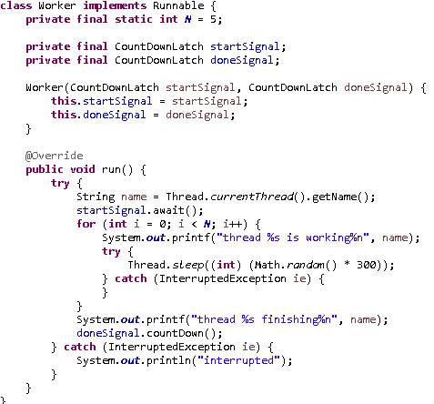
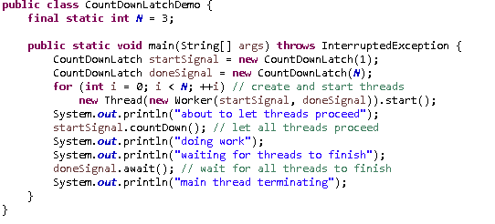
Working with Countdown Latch-

Slide 55
CyclicBarrier
A cyclic barrier is a thread-synchronization construct that lets a set of threads wait for each other to reach a common barrier point. The barrier is called cyclic because it can be re-used after the waiting threads are released.
A cyclic barrier is implemented by the java.lang.concurrent.CyclicBarrier class. This class provides the following constructors:
CyclicBarrier(int nthreads, Runnable barrierAction) causes a maximum of n-1 threads to wait at the barrier. When one more thread arrives, it executes the nonnull barrierAction and then all threads proceed. This action is useful for updating shared state before any of the threads continue.
CyclicBarrier(int nthreads) is similar to the previous constructor except that no runnable is executed when the barrier is tripped.
Useful in programs involving a fixed sized party of threads that must occasionally wait for each other.
The barrier is called cyclic because it can be re-used after the waiting threads are released.

Slide 56
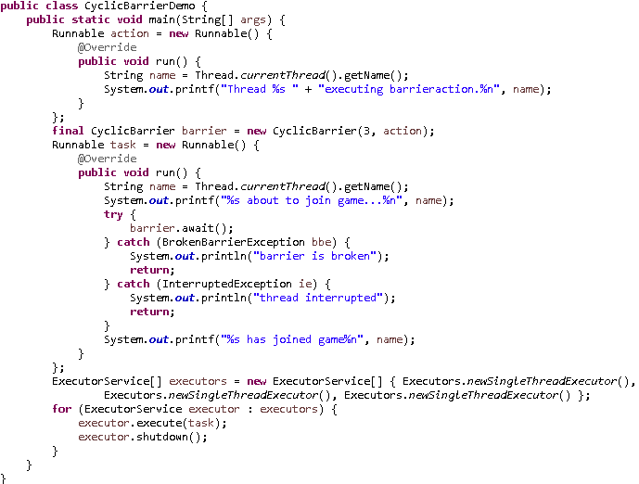
Working with Cyclic Barrier-
Reusing a CyclicBarrier
To reuse a CyclicBarrier instance, invoke its void reset()method.

Slide 57
CountDownLatch vs CyclicBarrier
The key difference is that CountDownLatch separates threads into waiters and arrivers while all threads using a CyclicBarrier perform both roles.
With a latch, the waiters wait for the last arriving thread to arrive, but those arriving threads don't do any waiting themselves.
With a barrier, all threads arrive and then wait for the last to arrive.
CyclicBarrier can be used to wait for Parallel Threads to finish.
you cant reset/reuse the countdownlatch.

Slide 58
CountDownLatch vs CyclicBarrier
CountDownLatch: If we want all of our threads to do
something + countdown
so that other waiting (for count to reach zero) threads can proceed, we can use countdown latch. All prior threads who actually did the countdown can go on in this situation but there is no guarantee that line processed after latch.countdown() will be after waiting for other threads to reach at latch.countdown() but it has a guarantee that other waiting threads will only start further after latch.await() has reached zero.
CyclicBarrier: If we want all our thread to
do something + await at common point + do something
(each await call will decrease wait time for threads to carry on further)
CyclicBarrier functionality can be achieved by CountDownLatch only once by calling latch.countdown() followed by latch.await() by all the threads.

Slide 59
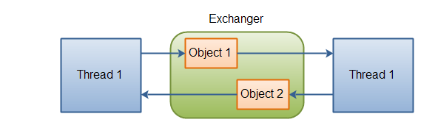
Exchanger
The Exchanger class is meant for exchanging data between two threads.
It waits until both the threads have called the exchange() method
An exchanger is more like an object for communication than synchronization
Exchangers are used on pairs of threads
Exchangers don't break like barriers can (not even when timeouts and interrupts occur)
An Exchanger may be viewed as a bidirectional form of a SynchronousQueue

Slide 60
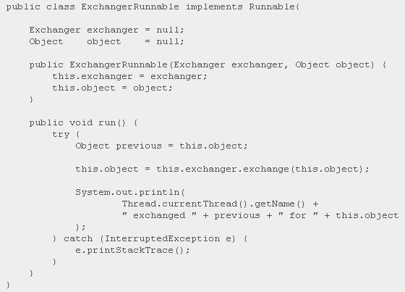
Exchanger
Exchanging objects is done via one of the two exchange() methods. Here is an example:
Usage
Exchangers may be useful in applications such as genetic algorithms and pipeline design. E.g. two threads on reading from the socket into a buffer and other consuming from a previously created buffer. They exchange as and when buffer is full/empty

Slide 61
Phaser
A reusable synchronization barrier, similar in functionality to CyclicBarrier and CountDownLatch but more powerful and flexible
Has an associated phase-number which is of type int
Has dynamic number of unarrived parties .
behaves like a CyclicBarrier but you can register a set of threads and at any time deregister, achieving a level of customization not possible with the other synchronizers.
The basic task of Phaser is that it registers the task, start and then deregisters.
If you need to wait for threads to arrive before you can continue or start another set of tasks, then Phaser is a good choice.
Supports operations for arriving, awaiting, termination, deregistration and registration
When all party arrives, Phaser advances (increments the phase-number)

Slide 62
Phaser
register() - It registers the unarrived parties to Phaser. If the parent is registered, its child will also be registered. This method waits for completion, if onAdvance() method is running.onAdvance() in Java Phaser
onAdvance() - methods returns boolean value. When it returns true, Phaser will reach to termination point. This method is overridden to return conditional Boolean values. By default it value is true.
arriveAndAwaitAdvance() :Party arrives to Phaser and awaits to complete others. The use of arriveAndAwaitAdvance() method is to await in the case of interruption or timeout.
arriveAndDeregister() : Party arrives to Phaser and de registers to itself. If deregistration makes a phaser of zero party and that Phaser has parent also then Phaser will also be deregistered from parent.
isTerminated() : It returns Boolean value. If terminated the returns true otherwise false.
Notes:
http://docs.oracle.com/javase/7/docs/api/java/util/concurrent/Phaser.html

Slide 63
CountDownLatch/CyclicBarrier/Phaser
CountDownLatch | Cyclic Barrier | Phaser
Fixed number of parties | Fixed number of parties | Dynamic number of parties
Not reusable as you have to create another CountDownLatch for each synchronize point | Reusable that how it differ from CountDownLatch but all threads must wait for each party to arrive at the barrier. | Reusable
It is Advanceable as latch.countDown() do the advance and latch.await() do the waiting part | Not advanceable | Advanceable : phaser.arrive() that how it advance

Slide 64
Fail fast vs Fail safe Iterators
As name suggest fail-fast Iterators fail as soon as they realized that structure of Collection has been changed since iteration has begun. Structural changes means adding, removing or updating any element from collection while one thread is Iterating over that collection. fail-fast behavior is implemented by keeping a modification count and if iteration thread realizes the change in modification count it throwsConcurrentModificationException.
Contrary to fail-fast Iterator, fail-safe iterator doesn't throw any Exception if Collection is modified structurally while one thread is Iterating over it because they work on clone of Collection instead of original collection and that’s why they are called as fail-safe iterator. Iterator of CopyOnWriteArrayList is an example of fail-safe Iterator also iterator written by ConcurrentHashMap keySet is also fail-safe iterator and never throw ConcurrentModificationException in Java.
Iterator returned by synchronized Collection are fail-fast while iterator returned by concurrent collections are fail-safe in Java.

Slide 65
Exercise
Implement a scenario using countdown latch to load data from 3 different sources (DBs, xml, etc) and then main thread do the processing.
Implement a scenario using cyclic barrier such that 3 players need to start a race, should wait for each other till all the player reach at a starting point.
Implement a print queue for a printer that can be used by concurrent tasks to print their jobs. This print queue will be protected by a binary semaphore, so only one thread can print at a time.
Implement an example where three tasks look for files with the extension .log modified in the last 24 hours in three different folders and their subfolders. This task is divided into three steps:
1. Get a list of the files with the extension .log in the assigned folder and its subfolders.
2. Filter the list created in the first step by deleting the files modified more than 24 hours ago.
3. Print the results in the console. At the end of the steps 1 and 2 we check if the list has any elements or not. If it hasn't any element, the thread ends its execution and is eliminated from the the phaser class.

Slide 66
Recap
Executor Framework
Working with Executor Framework
Future and callable
Concurrent Collections
BlockingQueue
Array BlockingQueue
Linked BlockingQueue
DelayQueue
SynchronousQueue
BlockingDequeue
Linked BlockingDequeue
Concurrent HashMap
ConcurrentNavigableMap
ConcurrentSkipListMap
CopyOnWriteArrayList
Synchronizers
Semaphore
CountDownLatch
Cyclic Barrier
Exchanger
Phaser
Fail fast vs Fail safe Iterators

Slide 67
References
http://docs.oracle.com/javase/6/docs/api/java/util/concurrent/ArrayBlockingQueue.html
http://www.javacodegeeks.com/2010/09/java-best-practices-queue-battle-and.html
http://docs.oracle.com/javase/7/docs/api/java/util/concurrent/BlockingDeque.html
http://docs.oracle.com/javase/7/docs/api/java/util/concurrent/ConcurrentMap.html
http://docs.oracle.com/javase/7/docs/api/java/util/concurrent/ConcurrentNavigableMap.html
http://docs.oracle.com/javase/7/docs/api/java/util/concurrent/CyclicBarrier.html
http://docs.oracle.com/javase/7/docs/api/java/util/concurrent/Exchanger.html
http://docs.oracle.com/javase/7/docs/api/java/util/concurrent/Phaser.html
http://wiserhawk.blogspot.in/2016/05/how-to-decide-pool-size-for-thread-pools.html

Slide 68
THANK YOU

